Slide 1



Artificial Intelligence for Patient Management
and Clinical Research in Rheumatology
Developed by:
Mr. Ismail Bakraoui
Under the supervision of :
Dr. Housbane Samy and Dr. Ajbal Khaoula
23 February 2025 - 2nd Meeting
EMSI - FMPC

Slide 2
Plan
Frontend
Backend
Model choice
Abstract
Discussion
2

Slide 3
Frontend
3

Slide 4
Points to circle over
Key Enhancements:
Visual Consistency: Clear fonts, familiar color palette, and icons matching the old system.
Functional Parity: All previous features (patients, appointments, documents, analytics) fully retained.
Responsiveness & Performance: Adaptive layout with smooth transitions and feedback animations.
User Experience: Skeleton loaders, toast notifications, and optimistic UI updates for faster, more fluid interaction.
4

Slide 5
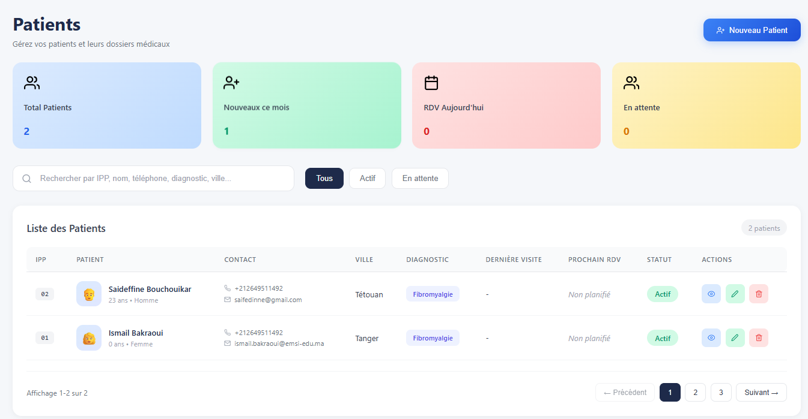
Points to circle over
5

Slide 6
Backend
6

Slide 7
Points to circle over
Acts as core orchestrator for all services.
Handles:
FastAPI routing (/api/auth, /api/patients, /api/appointments, etc.)
Database access (MySQL)
Features:
JWT-based authentication and RBAC (role-based access control)
Health and metrics endpoints for observability
Tested with Swagger
7

Slide 8
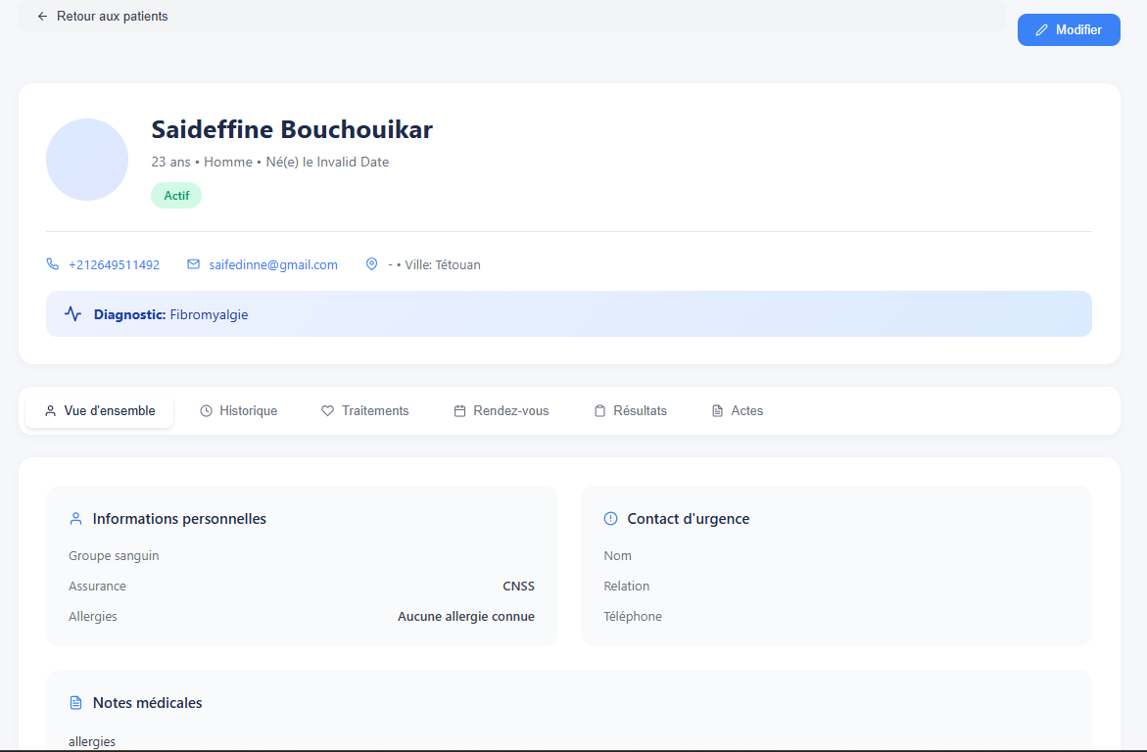
Points to circle over
8

Slide 9
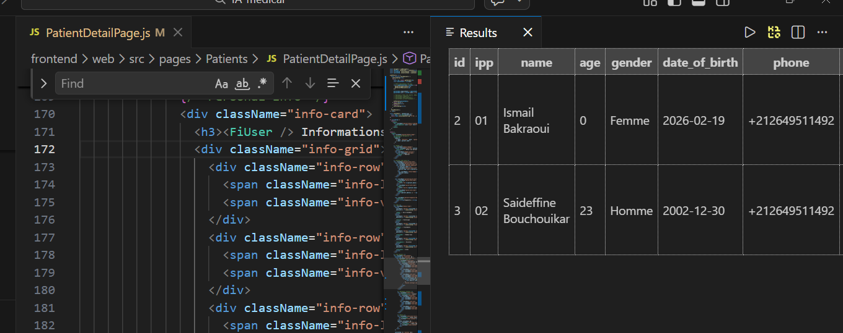
Points to circle over
9

Slide 10
Model choice
10

Slide 11
Why Biomistral?
Domain-Native Intelligence
Secure Local Deployment
Optimized for Clinical Decision Support
Scalable on Hospital Infrastructure
Cost-Effective & Sustainable
Fully Customizable
Strategic Independence
11

Slide 12
Abstract
12

Slide 13
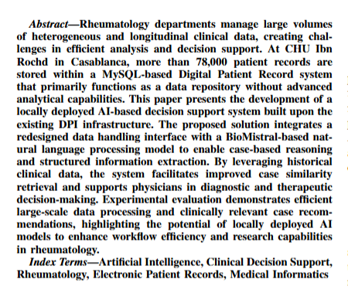
13

Slide 14
Discussion & Suggestions
14

Slide 15
Artificial Intelligence for Patient Management
and Clinical Research in Rheumatology
Developed by:
Mr. Ismail Bakraoui
Under the supervision of :
Dr. Housbane Samy and Dr. Ajbal Khaoula
23 February 2025 - 2nd Meeting
EMSI - FMPC

